Slide 1
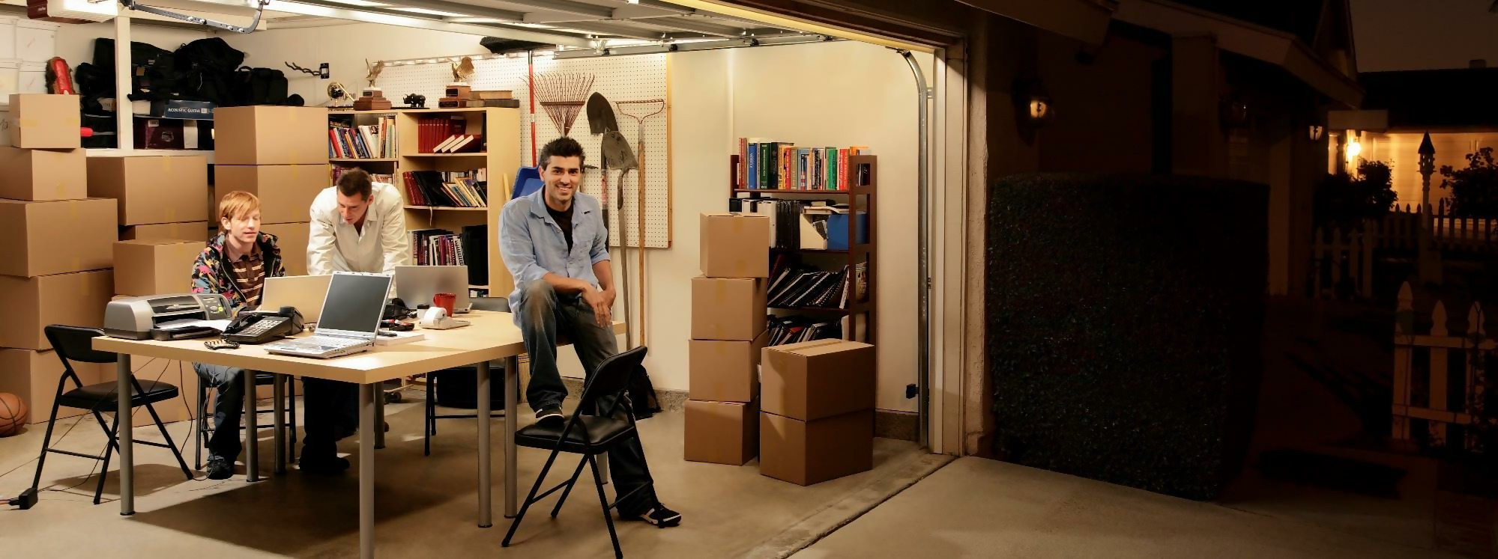
Individual presentation
Sachin Rajbhar
2/04/2022

Slide 2

Overview
Learnings
Challenges
Action Plan

Slide 3
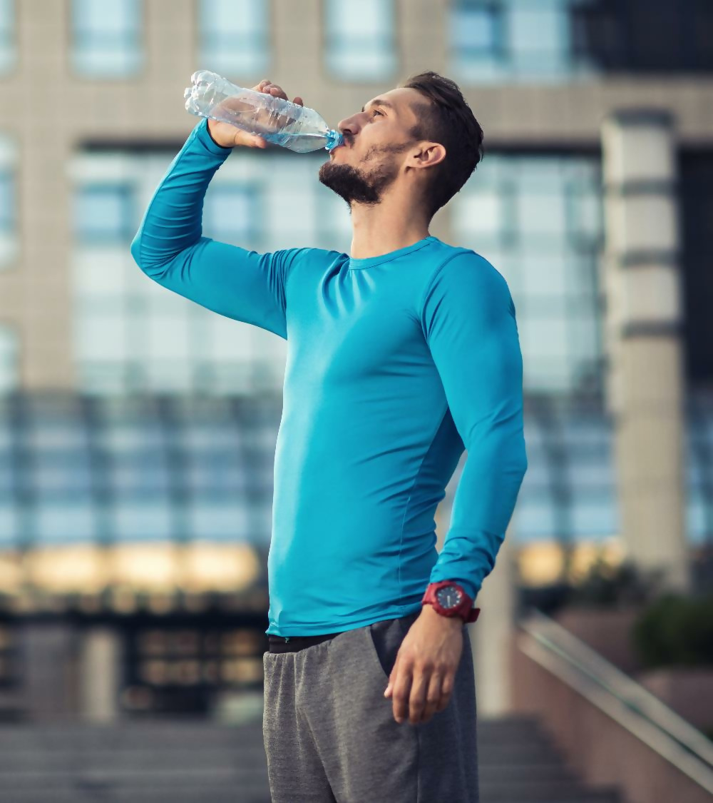
(Learnings) My Story
Building a Habit
Waking up early
Creating YouTube Vedios
Analyse things not doing
Not able to do it consistently
3 positives
Energetic feel
Time to focus
Positive environment

Slide 4

Managing the Situation
Sleep well and early
Leave phone at 9:30 pm
Do Work till 8:30 pm
Eat before 7:30 pm

Slide 5

Thank You
Email
officialsachinrajbhar@gmail.com
Phone
8285895280

